Slide 1
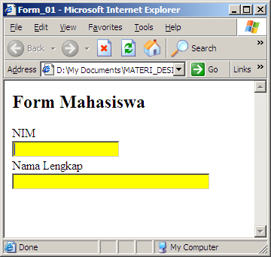
CSS (Cascading Style Sheet)
Form
<html>
<head>
<title>Form_01</title>
<style type=text/css>
input { background:yellow; }
</style>
</head>
<body>
<h2>Form Mahasiswa</h2>
<form name=form_mahasiswa>
NIM<br>
<input name=nim type=text size=20><br>
Nama Lengkap<br>
<input name=nama type=text size=40>
</form>
</body>
</html>
Catatan: untuk selector input berlaku pada,
<input type=radio>, <input type=checkbox>,
<input type=submit> & <inputy type=button>
BACK
NEXT

Slide 2
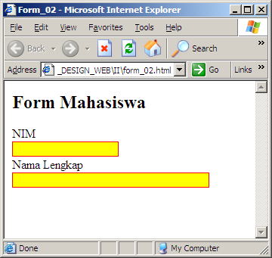
CSS (Cascading Style Sheet)
Form
<html>
<head>
<title>Form_02</title>
<style type=text/css>
input { background:yellow;
border: 1px solid red;}
</style>
</head>
<body>
<h2>Form Mahasiswa</h2>
<form name=form_mahasiswa>
NIM<br>
<input name=nim type=text size=20><br>
Nama Lengkap<br>
<input name=nama type=text size=40>
</form>
</body>
</html>
BACK
NEXT

Slide 3
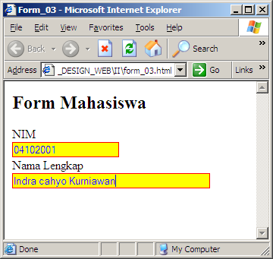
CSS (Cascading Style Sheet)
Form
<html>
<head>
<title>Form_03</title>
<style type=text/css>
input { background:yellow;
border: 1px solid red;
color: blue; }
</style>
</head>
<body>
<h2>Form Mahasiswa</h2>
<form name=form_mahasiswa>
NIM<br>
<input name=nim type=text size=20><br>
Nama Lengkap<br>
<input name=nama type=text size=40>
</form>
</body>
</html>
BACK
NEXT

Slide 4
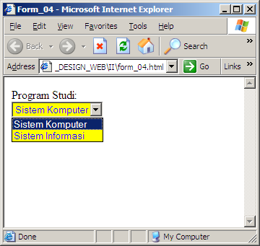
CSS (Cascading Style Sheet)
Form
<html>
<head>
<title>Form_04</title>
<style type=text/css>
select { background:yellow;
border: 1px solid red;
color: blue; }
</style>
</head>
<body>
<form>
Program Studi:<br>
<select name=prodi>
<option value=SK>Sistem Komputer</option>
<option value=SI>Sistem Informasi</option>
</select>
</form>
</body>
</html>
BACK
NEXT

Slide 5
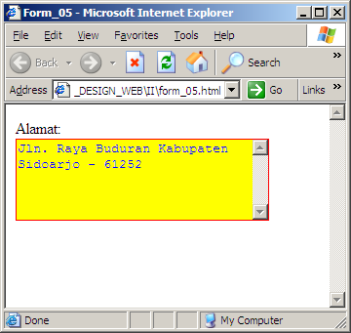
CSS (Cascading Style Sheet)
Form
<html>
<head>
<title>Form_05</title>
<style type=text/css>
textarea { background:yellow;
border: 1px solid red;
color: blue; }
</style>
</head>
<body>
<form>
Alamat:<br>
<textarea name=alamat cols=30 rows=5></textarea>
</form>
</body>
</html>
BACK
NEXT

Slide 6
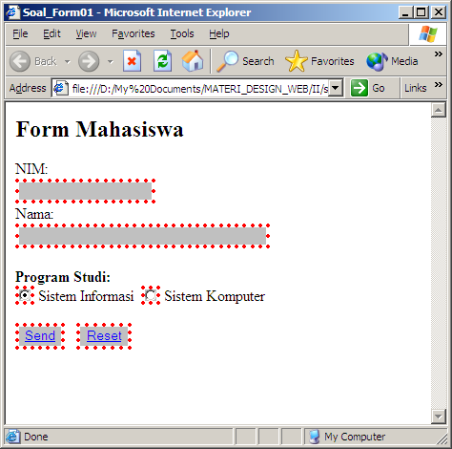
CSS (Cascading Style Sheet)
Soal (FORM_01)
Tuliskan Source Code dari tampilan berikut dengan menggunakan CSS:
PREVIEW
BACK
NEXT

Slide 7
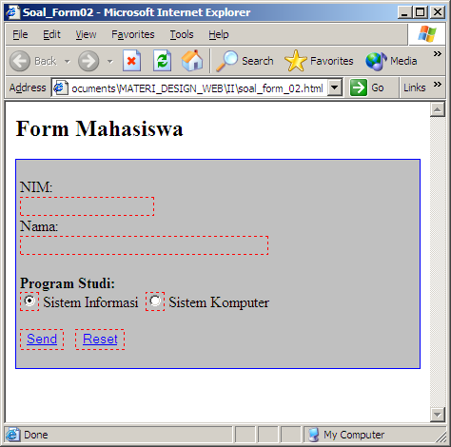
CSS (Cascading Style Sheet)
Soal (FORM_02)
Tuliskan Source Code dari tampilan berikut dengan menggunakan CSS:
PREVIEW
END

Slide 8
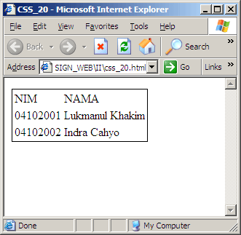
CSS (Cascading Style Sheet)
Table
<html>
<head>
<title>CSS_20</title>
<style type=text/css>
table { border: 1px solid black; }
</style>
</head>
<body>
<table>
<tr>
<td>NIM</td><td>NAMA</td>
</tr>
<tr>
<td>04102001</td><td>Lukmanul Khakim</td>
</tr>
<tr>
<td>04102002</td><td>Indra Cahyo</td>
</tr>
</table>
</body></html>
Catatan: Untuk declaration solid dapat juga menggunakan kode heksa
BACK
NEXT

Slide 9
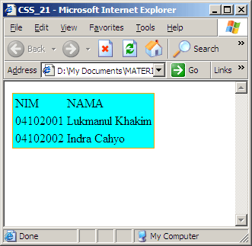
CSS (Cascading Style Sheet)
Table
<html>
<head>
<title>CSS_21</title>
<style type=text/css>
table { background-color: cyan;
border: 1px solid orange; }
</style>
</head>
<body>
<table>
<tr>
<td>NIM</td><td>NAMA</td>
</tr>
<tr>
<td>04102001</td><td>Lukmanul Khakim</td>
</tr>
<tr>
<td>04102002</td><td>Indra Cahyo</td>
</tr>
</table>
</body></html>
BACK
NEXT

Slide 10
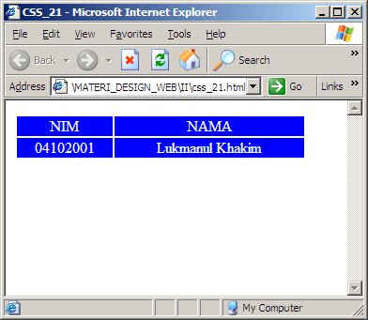
CSS (Cascading Style Sheet)
Table
<html>
<head>
<title>CSS_22</title>
<style type=text/css>
tr {background-color: blue;
color:white;
text-align:center;}
</style>
</head>
<body>
<table>
<tr>
<td width=100>NIM</td><td width=200>NAMA</td>
</tr>
<tr>
<td>04102001</td><td>Lukmanul Khakim</td>
</tr>
</table></body></html>
Catatan: deklarasi border tidak berlaku pada selector <TR>
BACK
NEXT

Slide 11
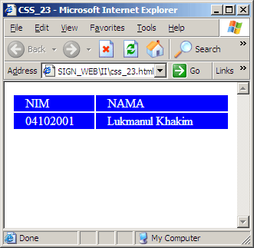
CSS (Cascading Style Sheet)
Table
<html>
<head>
<title>CSS_23</title>
<style type=text/css>
td {background-color: blue;
color:white;
padding-left: 15px;
</style>
</head>
<body>
<table><tr>
<td width=100>NIM</td><td width=200>NAMA</td>
</tr>
<tr>
<td>04102001</td><td>Lukmanul Khakim</td>
</tr></table>
</body></html>
Catatan: deklarasi padding tidak berlaku pada selector <TR>
BACK
NEXT

Slide 12
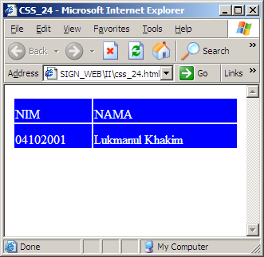
CSS (Cascading Style Sheet)
Table
<html>
<head>
<title>CSS_24</title>
<style type=text/css>
td {background-color: blue;
color:white;
padding-top: 10px;}
</style>
</head>
<body>
<table><tr>
<td width=100>NIM</td><td width=200>NAMA</td>
</tr>
<tr>
<td>04102001</td><td>Lukmanul Khakim</td>
</tr></table>
</body></html>
Catatan: deklarasi padding tidak berlaku pada selector <TR>
BACK
NEXT

Slide 13
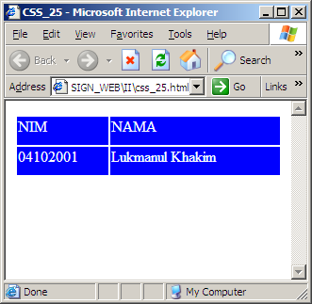
CSS (Cascading Style Sheet)
Table
<html>
<head>
<title>CSS_25</title>
<style type=text/css>
td {background-color: blue;
color:white;
padding-bottom: 10px;}
</style>
</head>
<body>
<table><tr>
<td width=100>NIM</td><td width=200>NAMA</td>
</tr>
<tr>
<td>04102001</td><td>Lukmanul Khakim</td>
</tr></table>
</body></html>
Catatan: deklarasi padding tidak berlaku pada selector <TR>
BACK
NEXT

Slide 14
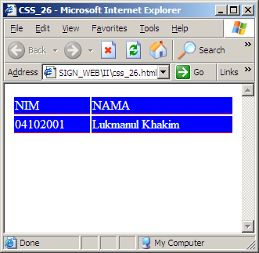
CSS (Cascading Style Sheet)
Table
<html>
<head>
<title>CSS_26</title>
<style type=text/css>
td {background-color: blue;
color:white;
border-bottom: 1px solid red;}
</style>
</head>
<body>
<table><tr>
<td width=100>NIM</td><td width=200>NAMA</td>
</tr>
<tr>
<td>04102001</td><td>Lukmanul Khakim</td>
</tr></table>
</body></html>
BACK
NEXT

Slide 15
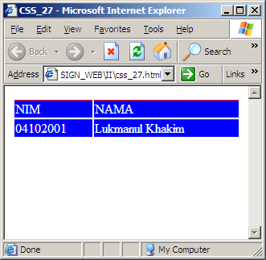
CSS (Cascading Style Sheet)
Table
<html>
<head>
<title>CSS_27</title>
<style type=text/css>
td {background-color: blue;
color:white;
border-top: 1px solid red;}
</style>
</head>
<body>
<table><tr>
<td width=100>NIM</td><td width=200>NAMA</td>
</tr>
<tr>
<td>04102001</td><td>Lukmanul Khakim</td>
</tr></table>
</body></html>
BACK
NEXT

Slide 16
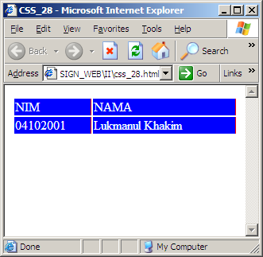
CSS (Cascading Style Sheet)
Table
<html>
<head>
<title>CSS_28</title>
<style type=text/css>
td {background-color: blue;
color:white;
border-right: 1px solid red;}
</style>
</head>
<body>
<table><tr>
<td width=100>NIM</td><td width=200>NAMA</td>
</tr>
<tr>
<td>04102001</td><td>Lukmanul Khakim</td>
</tr></table>
</body></html>
BACK
NEXT

Slide 17

CSS (Cascading Style Sheet)
Table
<html>
<head>
<title>CSS_29</title>
<style type=text/css>
td {background-color: blue;
color:white;
border-left: 1px solid red;}
</style>
</head>
<body>
<table><tr>
<td width=100>NIM</td><td width=200>NAMA</td>
</tr>
<tr>
<td>04102001</td><td>Lukmanul Khakim</td>
</tr></table>
</body></html>
BACK
NEXT

Slide 18
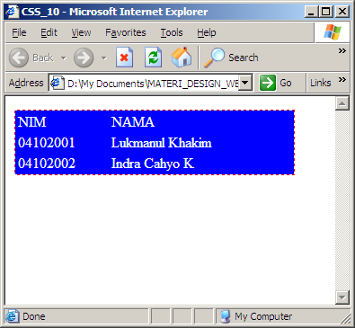
CSS (Cascading Style Sheet)
Soal (10)
Tuliskan Source Code dari tampilan berikut dengan menggunakan CSS:
PREVIEW
BACK
NEXT

Slide 19
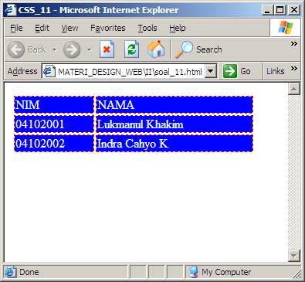
CSS (Cascading Style Sheet)
Soal (11)
Tuliskan Source Code dari tampilan berikut dengan menggunakan CSS:
PREVIEW
BACK
NEXT

Slide 20
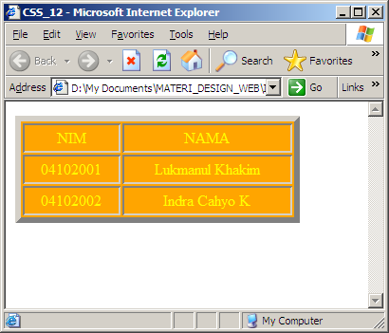
CSS (Cascading Style Sheet)
Soal (12)
Tuliskan Source Code dari tampilan berikut dengan menggunakan CSS:
PREVIEW
BACK
NEXT

Slide 21
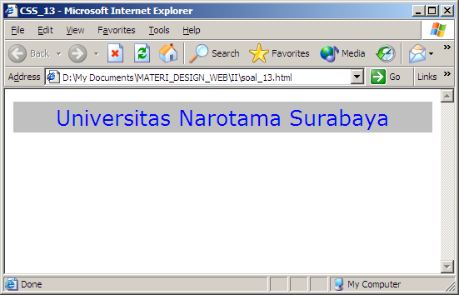
CSS (Cascading Style Sheet)
Soal (13)
Tuliskan Source Code dari tampilan berikut dengan menggunakan CSS:
PREVIEW
BACK
NEXT

Slide 22
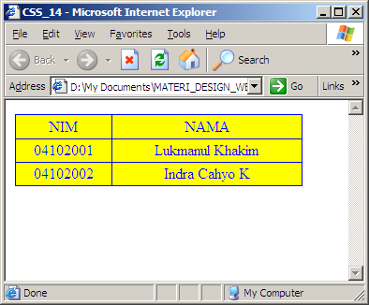
CSS (Cascading Style Sheet)
Soal (14)
Tuliskan Source Code dari tampilan berikut dengan menggunakan CSS:
PREVIEW
BACK
NEXT

Slide 23
CSS (Cascading Style Sheet) Classes
Penulisan
<style type=text/css>
.variable { … deklarasi … }
</style>
Catatan: bagian deklarasi harus diawali dengan tanda . (titik)
BACK
NEXT

Slide 24
CSS (Cascading Style Sheet) Classes
Text
<html>
<head>
<title>Kelas_01</title>
<style type=text/css>
.text { font-family:tahoma; font-size: 16px;
color: #006699; font-weight: bold; }
</style>
</head>
<body>
<a class=text>Universitas Narotama Surabaya</a>
</body>
</html>
PREVIEW
BACK
NEXT

Slide 25
CSS (Cascading Style Sheet) Classes
Link
<html>
<head>
<title>Kelas (LINK)</title>
<style type=text/css>
.link { font-family:tahoma; color:#0000FF; text-decoration:underline;}
.link:hover,.link:active { font-family:tahoma;
color:#FF9900;text-decoration:underline; }
</style>
</head>
<body>
<a href=# class=link>Link 1</a><br><br>
<a href=# class=link>Link 2</a>
</body>
</html>
PREVIEW
BACK
NEXT

Slide 26
CSS (Cascading Style Sheet) Classes
Form
<html>
<head>
<title>Kelas_Form</title>
<style type=text/css>
.inputbox1 { background:silver; border: 1px dotted red;color: blue;}
.inputbox2 { background:silver; border: 1px solid blue;color: red;}
</style>
</head>
<body>
<h2>Form Mahasiswa</h2>
<form>
<br>&nbsp;NIM: <br>&nbsp;<input type=text name=nim size=20 class=inputbox1><br>&nbsp;Nama: <br>&nbsp;<input type=text name=nama size=40 class=inputbox2>
</form>
</body></html>
PREVIEW
BACK
NEXT

